Slide 1
Family, Work and Poverty: Neoliberalism,
Structural Change, and Social Cohesion

Slide 2
Carnoy’s Argument
Family: A social institution that fulfills important functions in society—replacing members of society, nurturing them and properly “installing” them into society.
Structural: Structure makes possible certain family forms, gender roles and relationships of the family to the workplace, but individuals reinforce or resist these changes;
Neoliberal Globalization: As neoliberal policies transform the economy—including labor markets, occupational structures, & where we live—they alter the way we live and relate to each other;
Women: The acceleration of change driven by neoliberalism means that women are increasingly a source of cheap and often highly educated labor. This in turn is challenging existing family forms, identities, and gender relations through the world.

Slide 3
Challenges & Contradiction
Responsibilities: Neoliberal policies have placed new and heavy financial and supportive responsibilities on the family, and by this, women.
Investment: Mainly in wealthy countries, the shift to neoliberalism means declining public support and increased need for private resources; the family is the central source of investment in knowledge—school, training, health—to develop productive members of society—convergence in the role of the family among countries…?
Contradiction: Decreases in public investment/support, while increasing the responsibilities and needs of families:
  Families are now expected to do more with less; to be the major source of support and cohesion even as the family is destabilized by structural and fiscal changes;
  Those families with sufficient resources will do well…

Slide 4
Neoliberalism and Challenges to the Family: the U.S.
The United States: Changes in labor markets have increased job insecurity, intensified family and work schedules, & intensified individual-level stress, isolation and pressure to “outsource” family obligations.
Changes are most evident along four sets of variables:
Children.
Family structure & Marriage formation.
Identity.
Inequality & Poverty.

Slide 5
Children
What’s the story here?
Timing and number of children:
  From asset to liability.
  Women having their first child between the ages 30 and 35 is the fastest growing group—in 2016 the over 30 age group surpassed the 20 age group for the first time (103-102/1,000);
  Average age for a women’s first child has risen from 21.4 years to 28 (1970 -2016). (CDC data)
  Overall household size has declined 2001-2014 (from 2.62 to 2.54), it increased in households where the householder had less than a high school degree: (from 2.67 to 2.87 ).
Notes:
Putting off child birth to pursue education, adventure, and professional achievement & due to a workplace paradigm that levies penalties on mothers. The U.S. is the only wealthy nation in the world without a federal paid parental leave policy, and childcare in this country is expensive and underregulated.

Slide 6
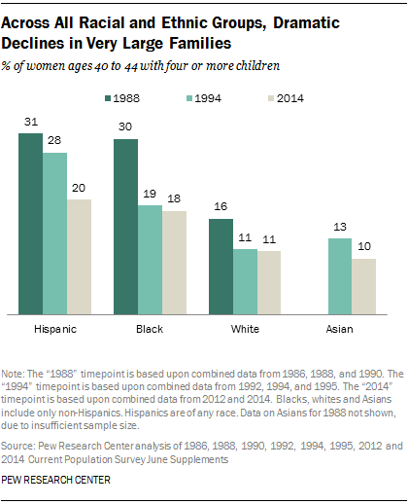
Family Size
    BUT

Slide 7
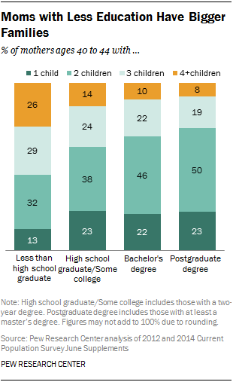
Education and the Number of Children
    Why does this matter?

Slide 8
Family Structure
Decline of the “traditional” family.
Increased instability due to increased insecurity driven by new flexible labor markets.
Rise of the Flexible Family: Combining consumption and investment functions.
Family is the the hub of productive and reproductive activity, but families structures vary—what many call fluid families.

Slide 9
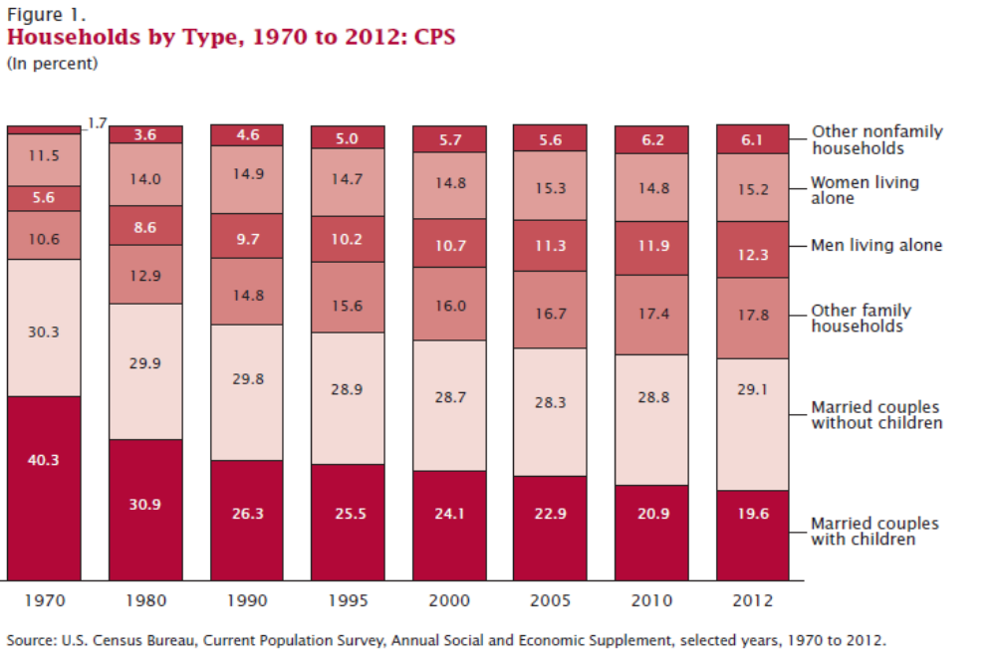
Family Structure: 1970 – 2012
Source: U.S. Census: Current Population Survey. Annual Social and Economic Supplement.

Slide 10
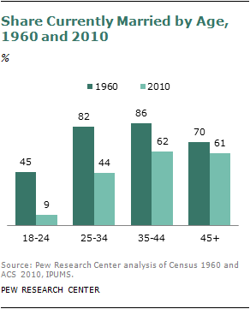
Percentage Share Currently Married by Age
Source: PEW Research Center analysis of Census 1960 and ACS 2010.

Slide 11
Marriage Timing:
Year
Men
Median Age
1950
2017
Women
1950
2017
22.8
29.5
20.3
27.4
Notes:
Sweden: women = 33 and men = 35
Norway: women = 32 and men = 34
Macedonia: women = 25.8 and men = 28.6
The wealthiest countries in Europe tend to have a higher average age at first marriage than their less developed counterparts.
Most of the young men and women in Nordic countries postpone marriage in pursuit of education and career first.
Many women prefer to live alone; and cohabiting is also a contributing factor

Slide 12
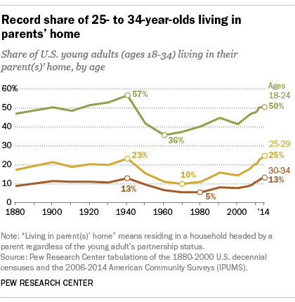
Living Arrangements of Young Adults

Slide 13
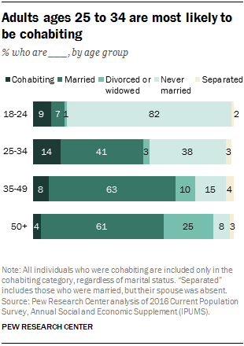
Adults Most Likely to Cohabitate
Notes:
Rising income inequality has divided American society, making college-educated people less likely to marry those without college degrees. Members of that educated group have struck a new path: they marry later and stay married. In contrast, women with only a high school diploma are increasingly opting not to marry the fathers of their children, whose fortunes have declined along with the country’s economic opportunities.

Slide 14
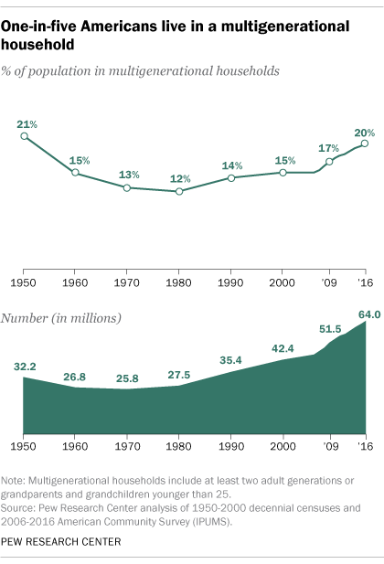
Share of US Population Living in Multi-generational Households

Slide 15
Relationships as Temporary
Instability: Structural changes and the family; comparing data from the U.S. Europe and Japan:
  Countries (US & Scandinavian) that have experienced the most economic structural change have higher divorce rates AND proportionately fewer traditional nuclear families.
Point: Carnoy argues today relationships are more temporary, more marriages are re-combinations of previously married people, and more people are cohabitating, the notion of the family is begin redefined—and this leads to conclusions that the family is in crisis.

Slide 16
Notes: Family Forms Vary
Internationally: more traditional family forms in Italy and Spain; less so in the US and Scandinavia.
National policies, culture, and the nature of structural changes are key.
US Regional Differences: single parents Asian and Latino families in the West; Blacks in the South; married couples with children are more common in Plains states, Midwest & South; unmarried parents living with an unmarried partner were concen­trated in the West and Southwest.
Social Separation (implications of growing inequality):
  College-educated people less likely to marry those without college degrees. More educated individuals marry later and stay married.
  Women with only a high school diploma are increasingly opting not to marry the fathers of their children.
Divorce is high today, but peaked in 1981. Today at its lowest rate since the 1980s—but data are not complete for all years; recent research suggest continued decline between 2008 & 2016.*
*https://osf.io/preprints/socarxiv/h2sk6/

Slide 17
Identity
Structural changes have challenged the conventional marital compact defining husbands as breadwinners and wives as homemakers:
Women: Women are increasingly members of the paid labor force and are (have) rejecting (rejected) “homemaker” as their primary identity;
Men: Labor market flexibility and incorporation of more married women into wage jobs mean men are called upon to be more flexible in their work schedules and contributions to the family;
Power: The structure of the traditional patriarchal family is challenged by the women’s increased contributions to family incomes; distribution of power within the family.

Slide 18
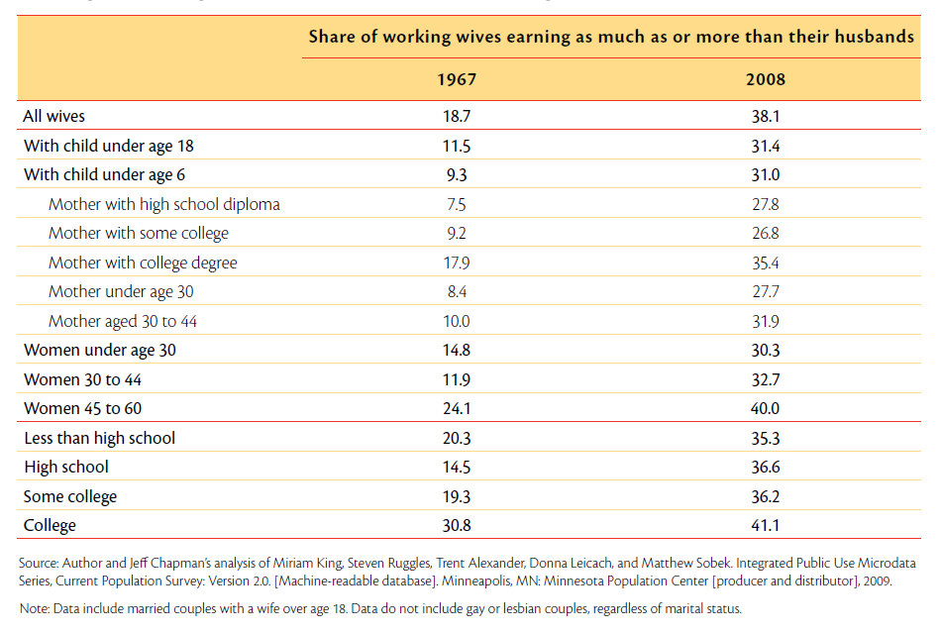
Bringing home the Bacon: Working wives bring home half or more: 1967-2008

Slide 19
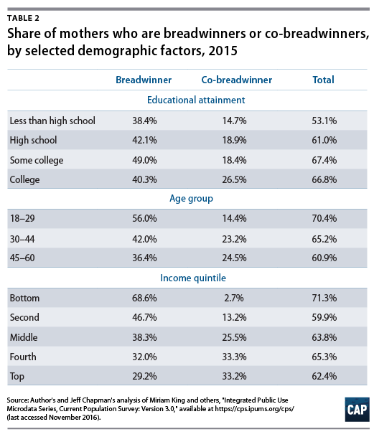
Bringing home the Bacon: 2015
Breadwinners = bringing in at least half of family earnings.
Co-Breadwinners = bringing home from 25 percent to 49 percent of earnings for their families.
https://www.americanprogress.org/issues/women/reports/2016/12/19/295203/breadwinning-mothers-are-increasingly-the-u-s-norm/

Slide 20
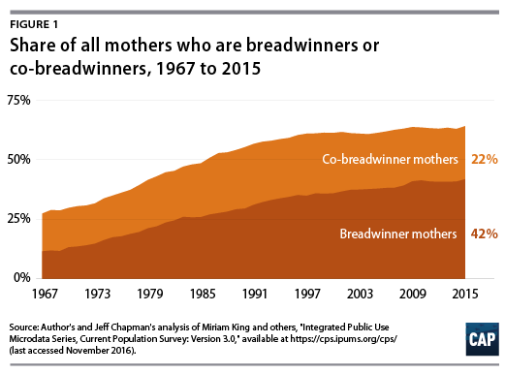
Share of All Mothers who are Co & Breadwinners: 1967-2015

Slide 21
Potential Results
Positive:
Power: Greater balance of power within the family that might lead to more democratic forms of the family;
Stability: Data is now showing that a wife's work can stabilize marriages.
Roles and Flexibility: As people become less defined by a single occupational role, they have to be more flexible; there is potential for greater tolerance and flexibility in their family (and social) roles.
Negative:
Tensions: Increased tensions as couples struggle to adapt to new roles and expectations within the family and demands of multiple roles outside the family. Who is/should be responsible for what….
Gender Roles: Roles are in flux and for many this is difficult to adjust;
  Men and women may actually work to support the social expectation of men’s dominance in order to preserve marital harmony, and gendered expectations.
Resistance: Attempts to resist change, such as arguments to return to the “traditional family” or to family values—working women the cause of “failing” families.

Slide 22
Inequality and Poverty:

Slide 23
Feminization of Poverty
Definition:
Absolute vs. Relative Poverty.
Children: When we discuss the feminization of poverty, we are also talking about children in poverty:
    18% of those under-18 yrs of age were in poverty (2017);16.7% (2002) compared to 14.9 in 1970; Note: The poverty rate for children varies substantially by race and Latino origin.
    Almost 40% of American kids spend at least 1 year in poverty before they turn 18.

Slide 24
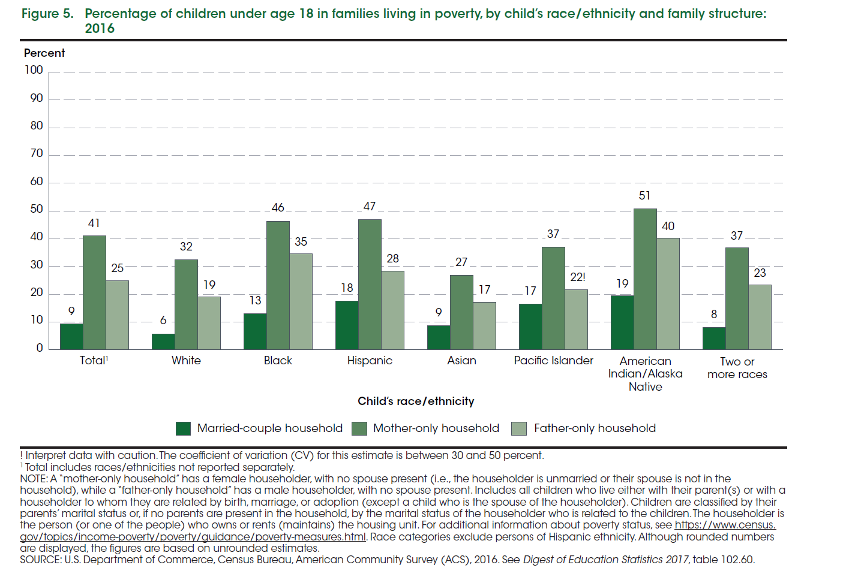
Childhood Poverty by Race/ethnicity and Family Structure, 2016

Slide 25
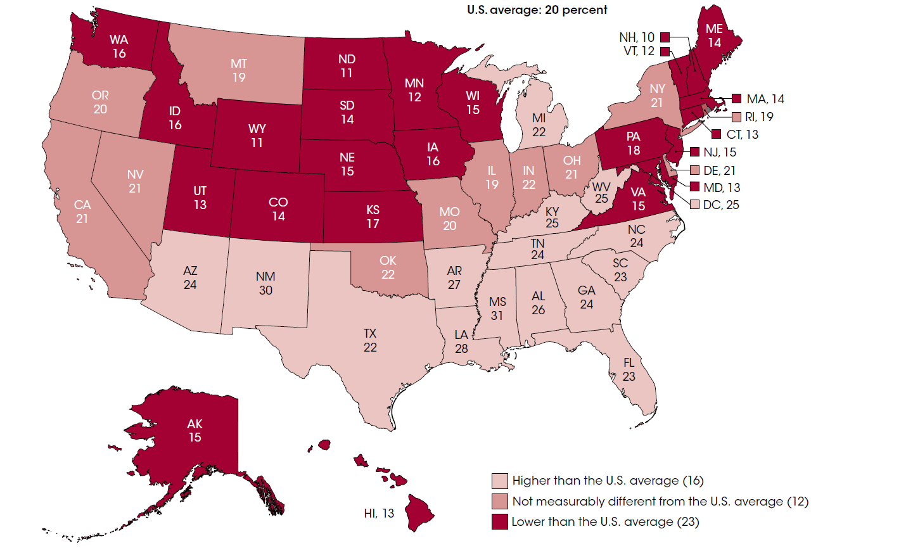
Geography Matters: Percentage of Children Living in Poverty by State

Slide 26
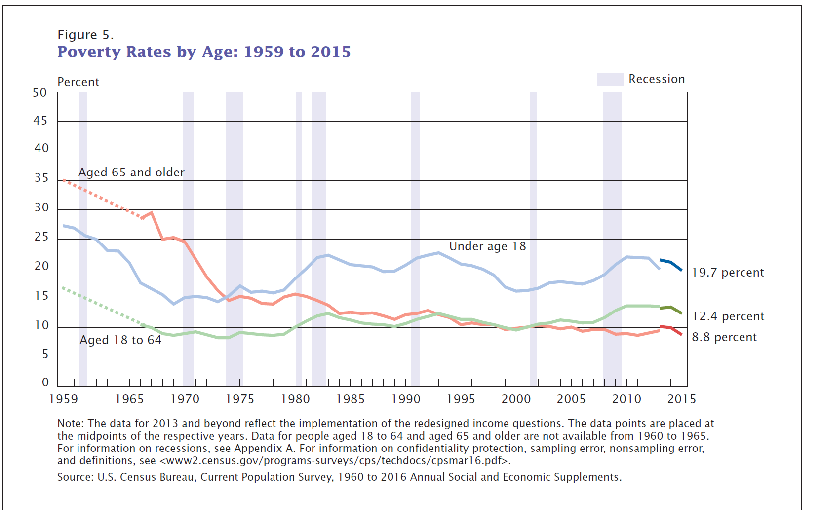

Slide 27
Women, Poverty & Income
Women: 14% of all women vs. 11% of all men were in poverty in 2017.
  25.7% of female-headed households were below the poverty level in 2017; vs 12.4% for men; married couples 4.9%
Female headed households rely almost exclusively on a woman’s wage. Only 4 in 10 custodial mothers (41.7 percent) receive any child support and only half (47.3 percent) of those awarded child support actually receive their full award.
  Note that award rates (in a divorce) are lower for African-American and Latina women which exacerbates the poverty rate

Slide 28
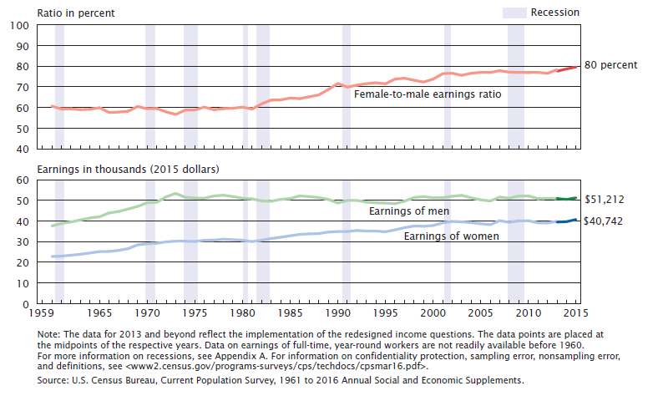
Female to Male Ratio and Median Earnings, full-time, year-round workers 15 yrs and older
Research shows that equal pay would cut poverty among working women and their families by more than half and add $513 billion to the national economy

Slide 29
Why?
Occupational Segregation:
  Inter-Occupational segregation
  Weekly (median) earnings (top 5 female & male jobs minimum 95%):
    Women = $ 799.00
    Men = $ 1,172.00
Responsible for 50% of wage differential
(https://iwpr.org/wp-content/uploads/2016/09/GWG-Talking-Points_2017.pdf)
Intra-Occupational Segregation:
  Law: All-M= $1,904; W= $1,152
    Lawyers M = $2,086; W= $1,619
  Medicine: All-M= $1,332; W= $1,036
    MDs: M= $2,343; W= $1,476
  Life, Physical & Soc Sci: M= $1,319; W= $1,119
https://iwpr.org/issue/employment-education-economic-change/pay-equity-discrimination/
https://iwpr.org/wp-content/uploads/wpallimport/files/iwpr-export/publications/C419.pdf

Slide 30
Gender meets the Hourglass
The jobs generating the most growth are retail sales, customer service representatives, food preparation/fast food workers, home health aids, child care workers, janitors and cleaners, general managers, wait staff, and nursing aides and orderlies—jobs in what is called the Secondary sector (low pay, few benefits).
Women make up more than 2/3 of the employees in all but 5 of the 15 fastest growing occupations characterized by low pay and few benefits (the main exception is Registered nurses).
Links: the increasing demands on the time of upper middle class professions means these families find it increasingly difficult to fulfill the normal family tasks.
Many of the occupations projected to have the greatest growth replace the work that women historically did without pay in the home before women entered the workplace in large numbers.

Slide 31
Matrix of domination* (intersectionality**)
The feminization of poverty: While reflecting the trend of increasing income and wealth inequality, has important consequences for racial and ethnic groups.
Matrix of domination: How the interaction of class and status affect our life chances; Thus, it isn’t any woman who is likely to be found in the low-wage sector.
Earnings for Black women and Latinas are lower than other demographic groups.
*Patricia Hill Collins; **Kimberlé Crenshaw

Slide 32
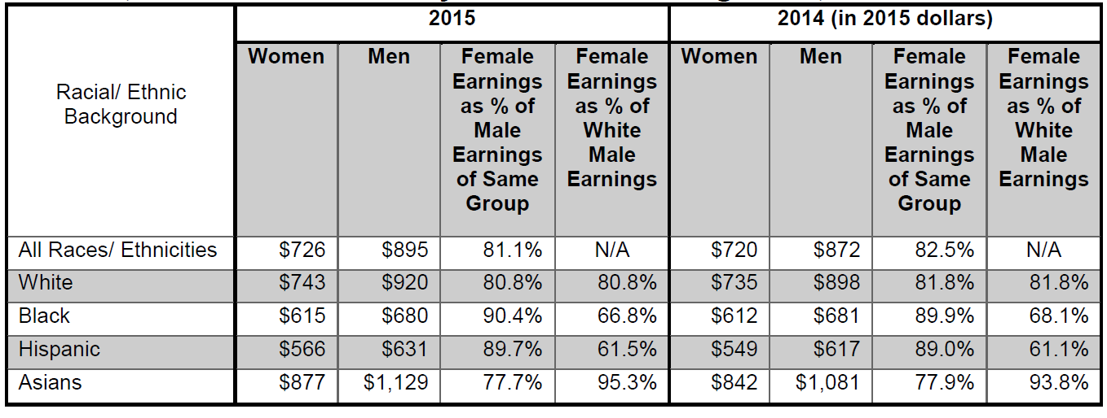
Median Weekly Earnings and Gender Earnings Ratio for Full-Time Workers, 16 Years and Older by Race/Ethnic Background:
Notes: Hispanics may be of any race. White, black and Asian workers include Hispanics. Annual average of median weekly earnings.
Source: U.S. Bureau of Labor Statistics.

Slide 33
Female Poverty by race and ethnicity:
1974 – 2017
 | 1973 | 1980 | 1985 | 1990 | 1995 | 2000 | 2005 | 2009 | 2017
Black | 31.4 | 32.5 | 31.3 | 31.9 | 29.3 | 22.5 | 24.9 | 27.5 | 21.2
Latina* | 21.9 | 25.7 | 29.0 | 28.1 | 30.3 | 21.5 | 21.8 | 27.4 | 18.3
White | 8.4 | 10.2 | 11.4 | 10.7 | 11.2 | 9.5 | 10.6 | 13.5 | 8.7
Asian | NA | NA | NA | 12.2 | 14.6 | 9.9 | 11.1 | 12.6 | 10.0
*Latina/Hispanic of any race
Source: U.S. Census Bureau.

Slide 34
Conclusion: Flexibility and Flexible Families
Women: In general paying a heavy cost in the flexible era;
Family: More than ever central:
  to temper the stress induced by economic changes: or the individualization of social and economic life driven by neoliberal globalization.
  to serve as a cushion against period of unemployment—boomerang kids.
  to fulfill the function of nurturing children and providing offspring with new kinds of knowledge at various points in their careers as they move through different kinds of work. Investment function.
Sum: The neoliberal model destabilizes the family: decreases the amount of resources and time parents have for their children and increases the resources necessary for investment in children. Thus, the model undermines the very institutions crucial to sustainable development: the family.

Slide 35
Policy U.S.
Improve educational and job training opportunities for women to enter highly paid jobs, including those currently dominated by men.
Increase the availability of subsidized child care and family-friendly work arrangements, such as paid family leave, paid sick days, and flexibility in work schedules to allow workers to meet their family responsibilities;--Importance of the public sector
Step up enforcement of equal pay and equal employment opportunity laws, including the active prevention of sexual harassment, to reduce discrimination in the workplace;
Protect women’s rights on the job, including the right to organize, since the gender wage gap is smaller among unionized workers than non-unionized workers.

